Slide 1
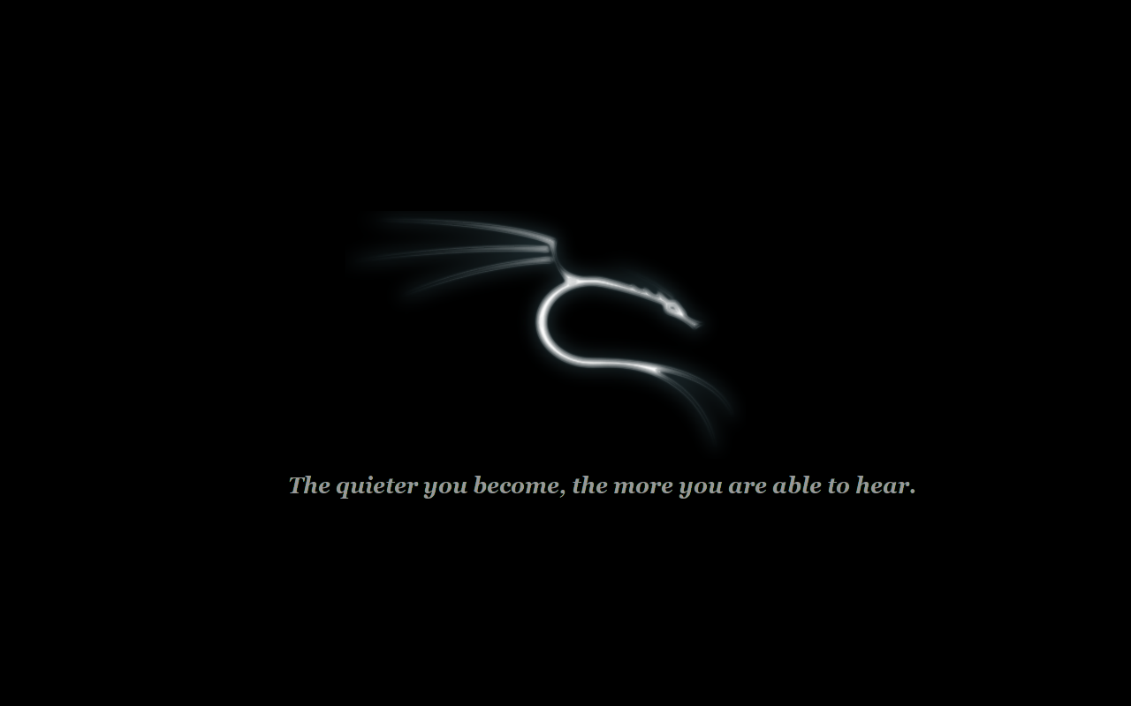
Backtrack and Kali in Digital Forensics
By: Josiah Bennett

Slide 2
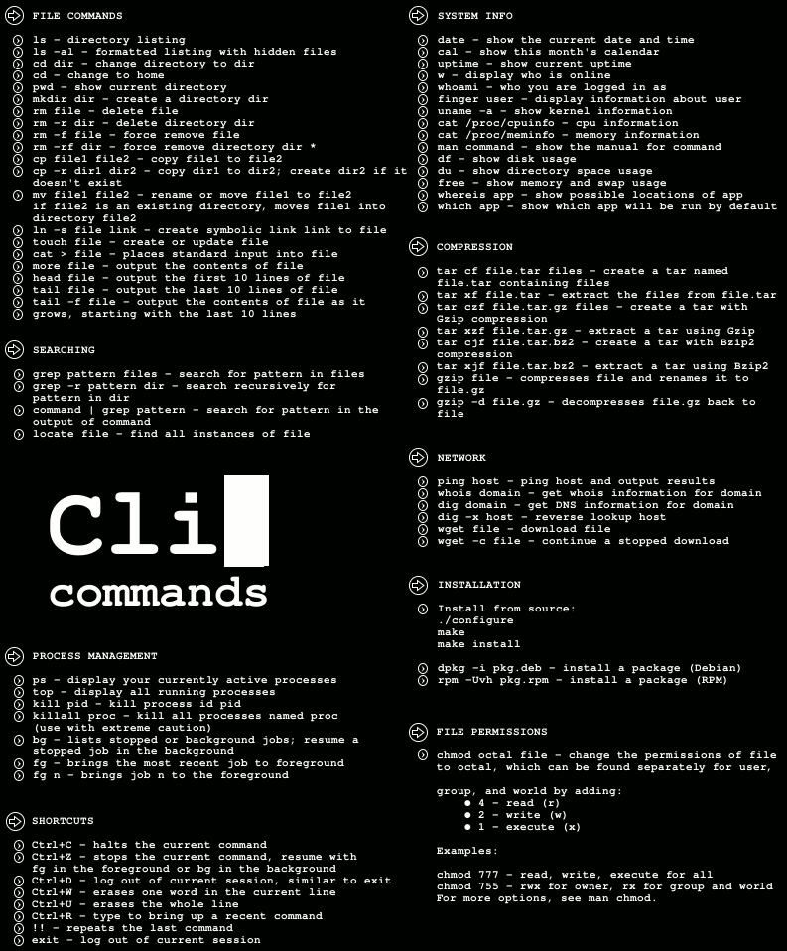
What makes me credible?
Experience
Research
Lab testing

Slide 3
My Goals
History of Backtrack Linux
Discuss the differences
Show the distributions
Forensic tools
Forensic tools in use
Conclusion
Questions

Slide 4
Backtrack Linux History
Five major upgrades throughout its main lifetime
Gained features over time with Backtrack R updates
Developed in the early stages as WOPPIX
Major focus was on computer security and penetration testing

Slide 5
Backtrack History Cont.
Gained popularity in the security industry for toolset
Verified multiple times using MD5 Hashing
Became a large competitor to the expensive toolsets
Evolved into Kali Linux in December 2012

Slide 6
What’s the difference
Backtrack Linux 5R3
Kali Linux
Roots stuck in KNOPPIX
Aged architecture
Limited expandability
Unusual File Structure (/pentest directory)
Designed for expandability
Adopted a Debian base
General Usability
Improved security options

Slide 7
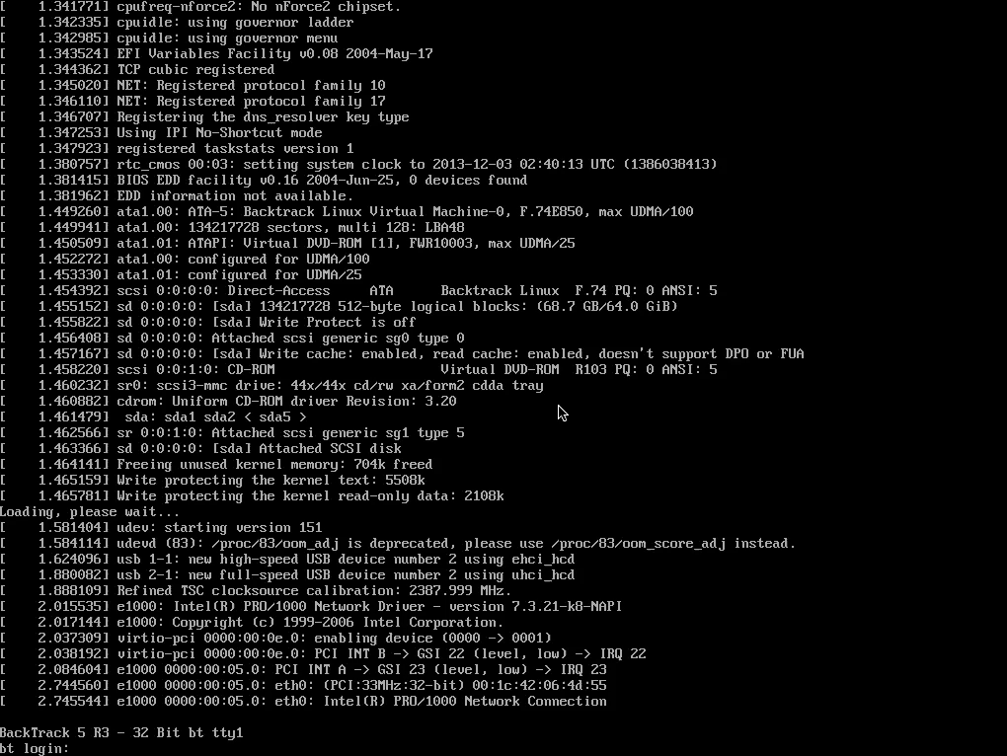
Backtrack Preview

Slide 8
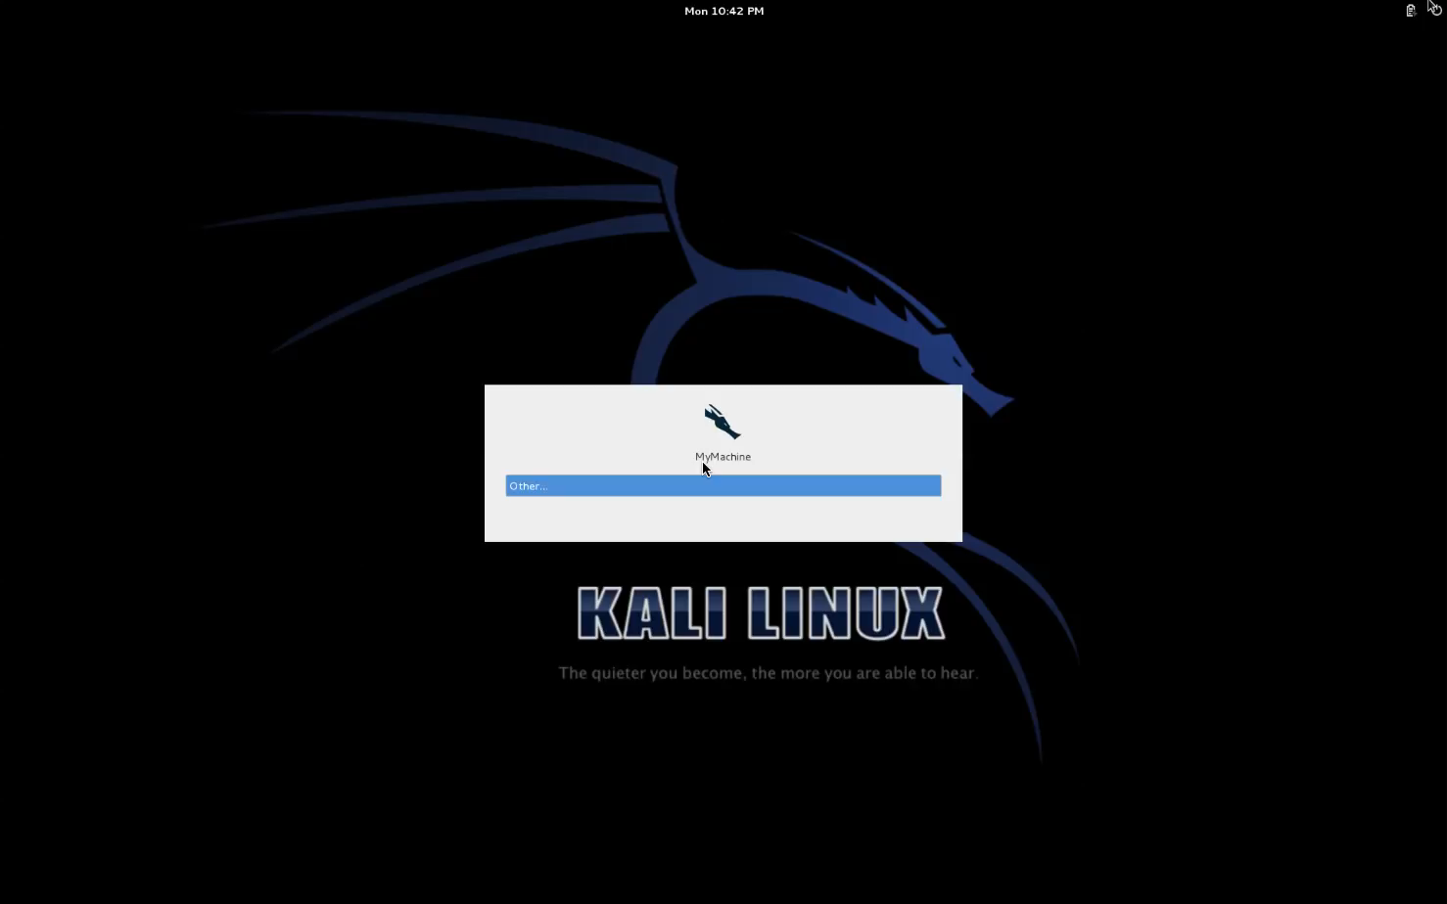
Kali Preview

Slide 9
Popular Forensic Utilities
Matasploit Framework
Network attack testing
Aircrack-ng
Wi-fi exploitation
Nmap
Creates network map
EtherApe
Graphical network Monitor

Slide 10
Demonstration

Slide 11
Growing in popularity
Backtrack / Kali Linux is expanding in popularity amongst many law enforcement agencies.

Slide 12
Individualized
With the change from Backtrack to Kali personalization of an investigators toolkit has become easier

Slide 13
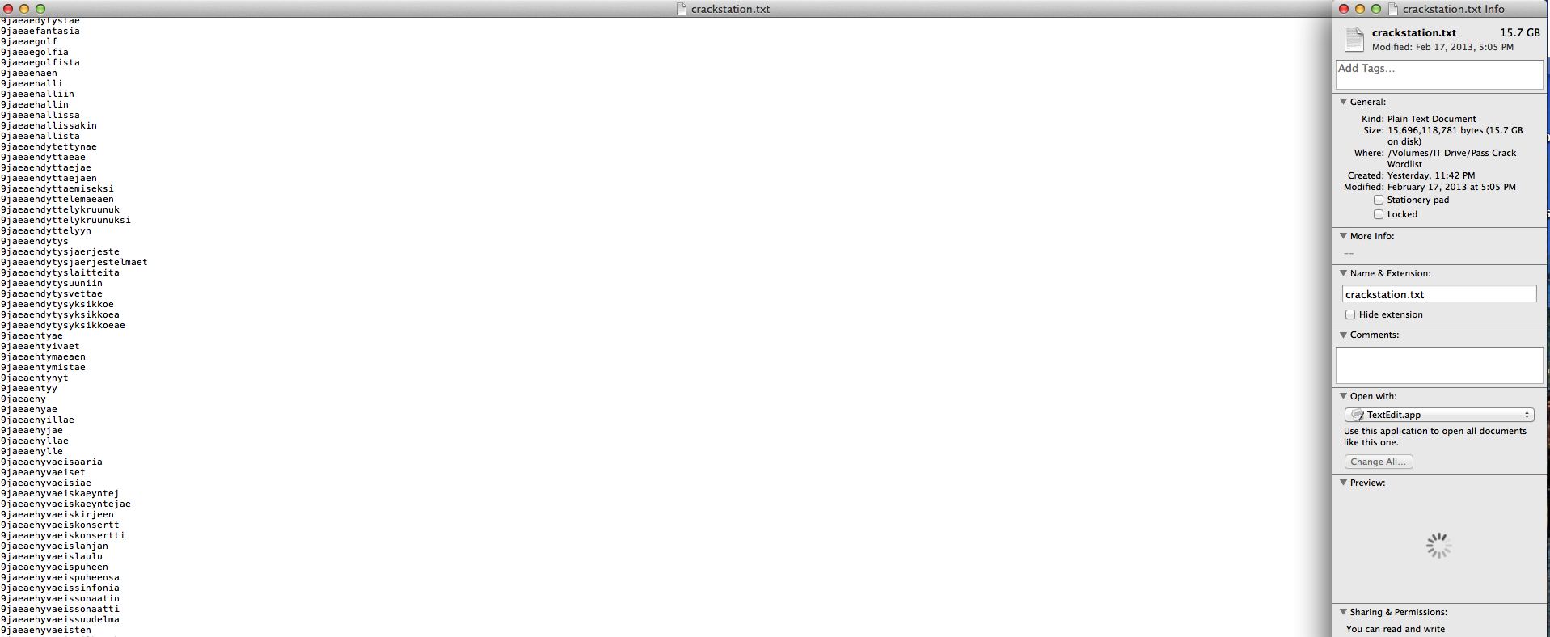
Password Cracking
JTR and Caine and Abel

Slide 14
Concluding statements
Backtrack Linux history
Kali Linux expanding
Kali Linux brought new abilities
The Linux forensic landscape is evolving quickly

Slide 15
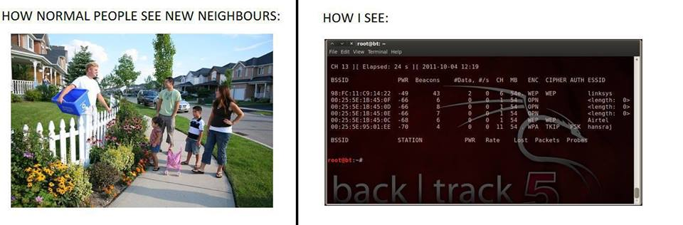
End

Slide 16
Links
http://www.kali.org
http://www.backtrack-linux.org
http://docs.kali.org

Slide 17
Questions?

Slide 18
Thank you!

